Slide 1
Socket.IO
Socket.IO is a library that enables real-time, bidirectional and event-based communication between the browser and the server. It consists of:
a Node.js server
a Javascript client library for the browser (which can be also run from Node.js)

Slide 2
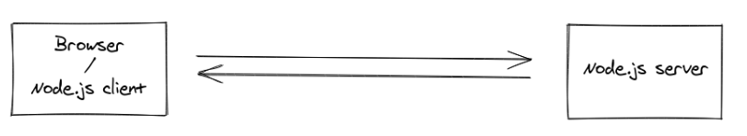
Socket.IO

Slide 3
Basic Terminology Of Socket.io
io.on(‘connection’,()=>{}) // whenever connection is stablished between client and server this function is called.
socket.on(‘name of event’,()=>{}) this is used both in client side and server side to listen to the event which is emitted by socket.emit and run the code inside it
socket.emit(‘name of event’,()=>{}) // this is used in both client side (js) and server side this emits the event which the client or server will listen to

Slide 4
Basic Terminology Of Socket.io
socket.on(‘disconnect’,()=>{}) internal socket function use it when you want to know when a client disconnects

Slide 5
Broadcasting
Broadcasting is defined as sending a message to all connected clients.
There are different levels of broadcasting the message

Slide 6
Broadcasting
socket.emit() vs socket.broadcast.emit() vs io.emit() these 3 events are used for emitting the difference between them is that socket.emit() will emit to only specific socket like it will emit to its only client , socket.broadcast.emit() will emit to all clients excepts to its own client (self client) and io.emit() will emit to all clients no exception.

Slide 7
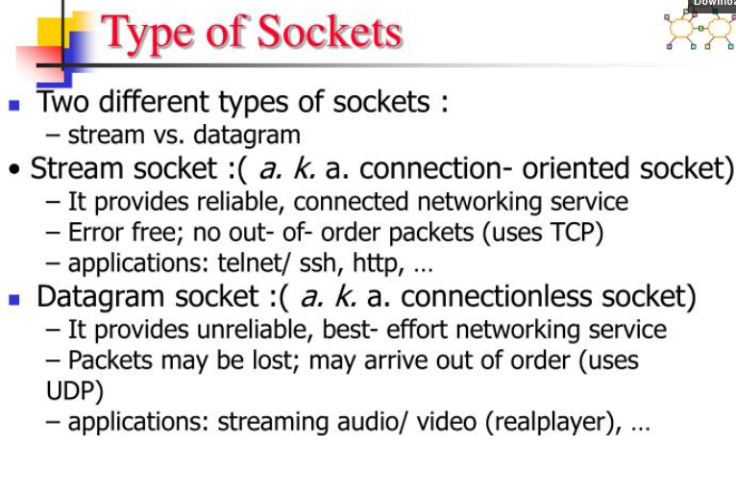

Slide 8
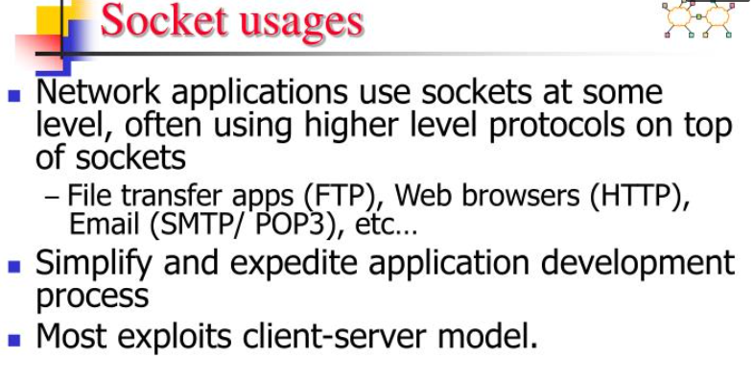

Slide 9
Set Up TCP Client/Server App with Node.js
What is TCP?
TCP stands for Transmission Control Protocol and is one of the TCP/IP internet protocols.
Using TCP, you can exchange data between a client and server in a reliable way.

Slide 10
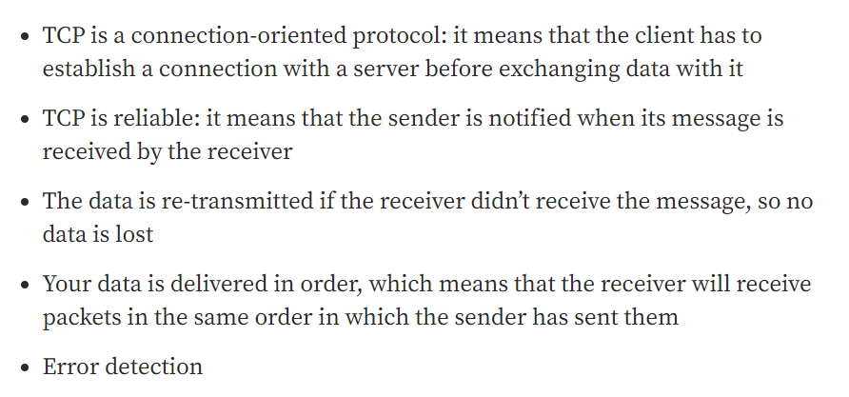
Main Features

Slide 11
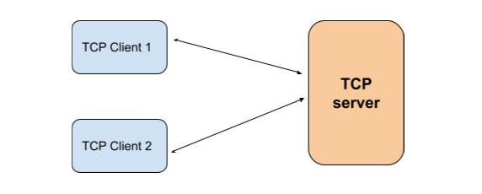
Application architecture
The server: it will listen on a specific port in which the client messages will come and will send a response to the client request.
The client will send to a server a message and wait for a response to its request

Slide 12
The TCP clients
“The net module provides an asynchronous network API for creating
stream-based TCP” , each client will:
connect to the server
send a message
wait for server response

Slide 13
The TCP server
After starting it, the server will listen on a specific port (Example: 2000) and will:
wait for a client connection
receive data from each connected client
send back a response to each connected client

